Slide 1


Scoring Method for Forming
a Rollersport Team
ERLANGGA ARDIANZA WIBOWO
UNIVERSITAS NEGERI SEMARANG - INDONESIA

Slide 2
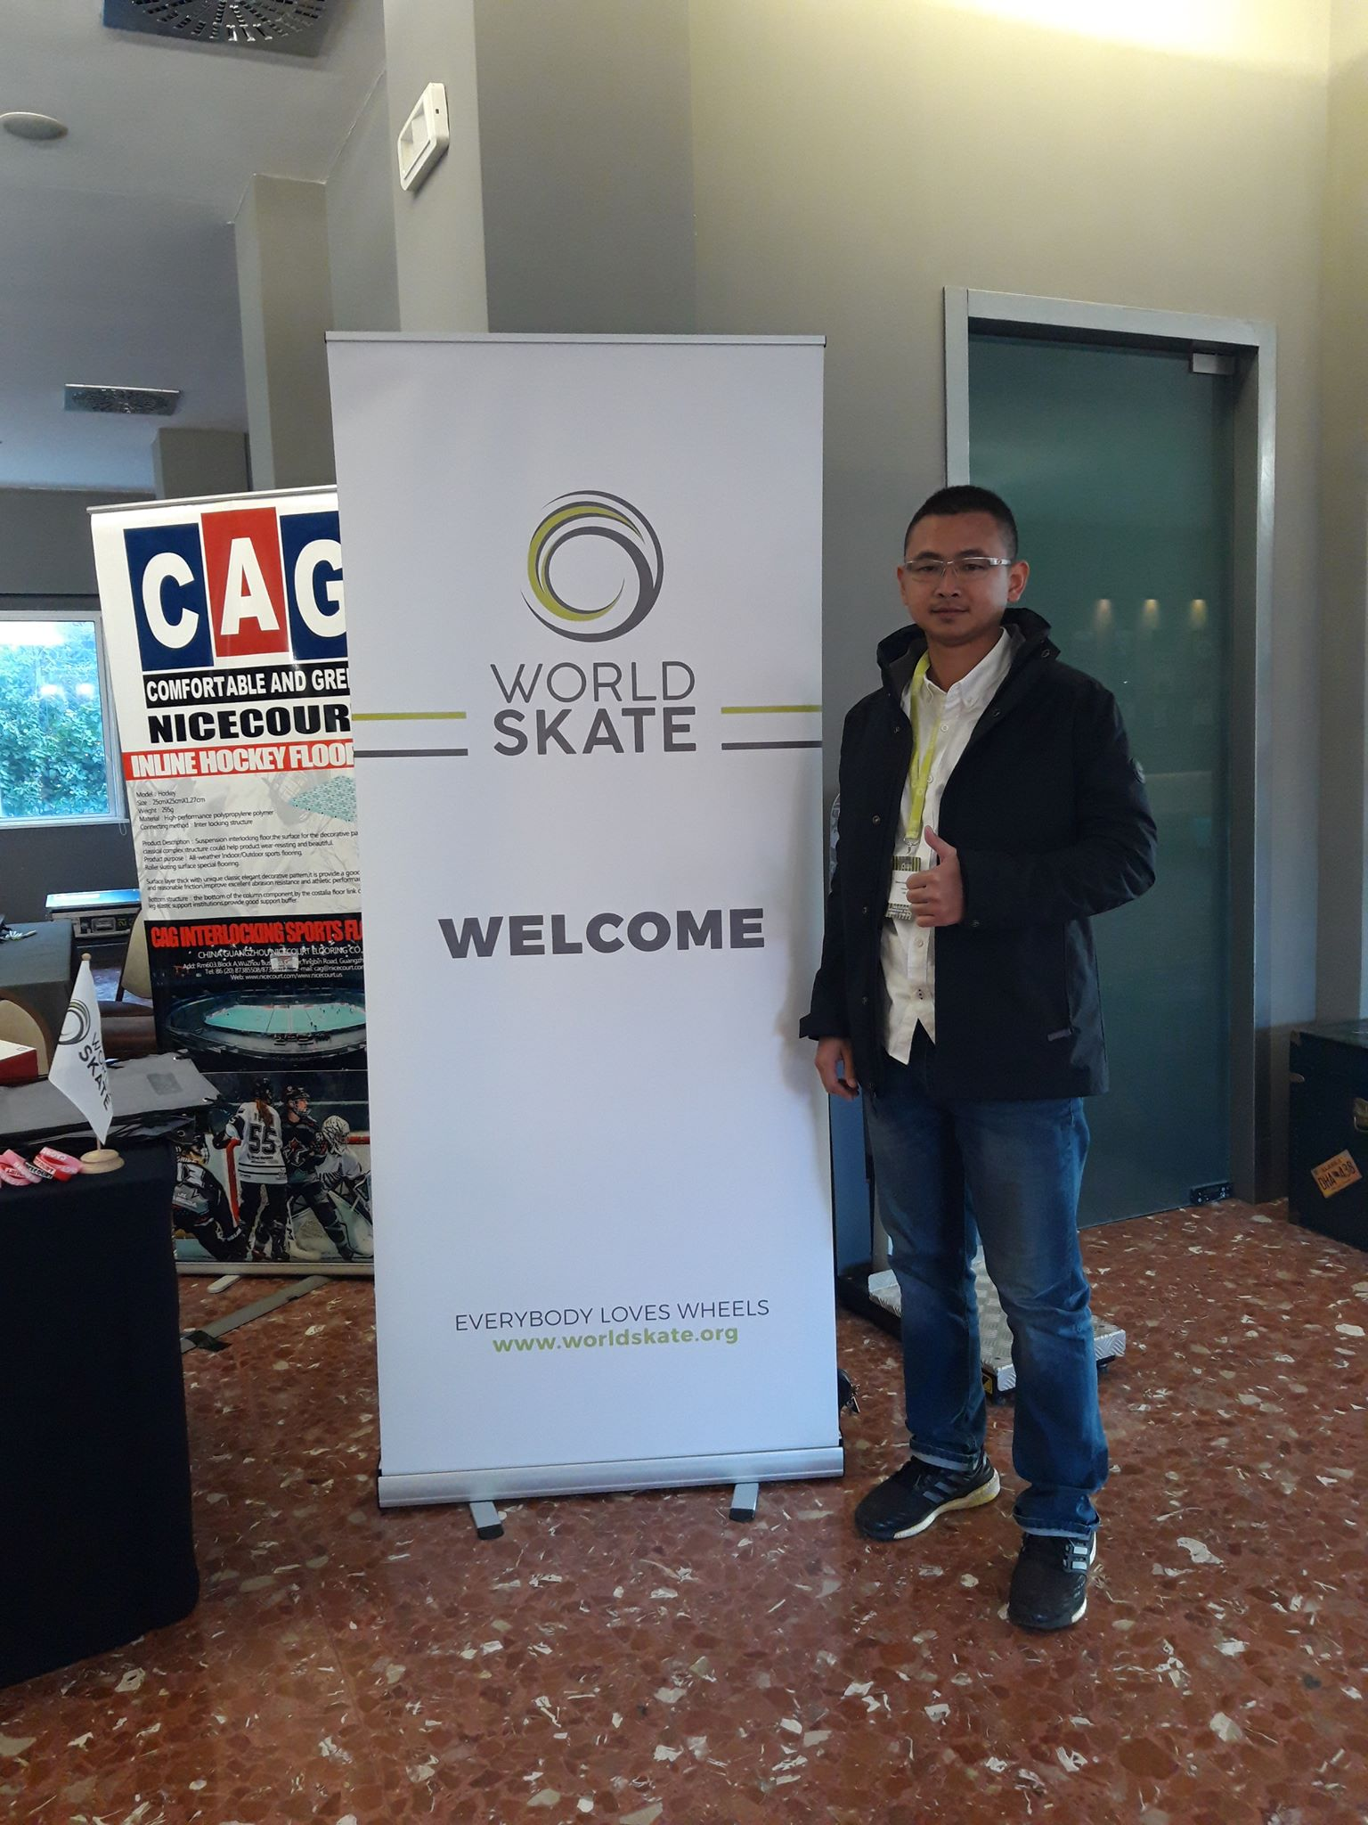
Name
Erlangga Ardianza Wibowo, S.T., S.Pd.
ardianz_eaw@yahoo.com
Education
Taruna Nusantara Senior High School
Bachelor of Industrial Engineering Diponegoro University
Bachelor of Sport Coaching Education Universitas Negeri Semarang
Master Student of Sport Education Universitas Negeri Semarang
Experience
Former Athlete with Gold Medal SEA GAMES 2011 Indonesia
National Coach of Roller Sport
Work at Youth and Sport Department Jawa Tengah Government
President of Jawa Tengah Roller Sport Federation
Deputy of Research and Development of KONI Jawa Tengah

Slide 3
INTRODUCTION
This study explore team formation process of the Central Java Rollersport Team, which in PON XX / 2021 only won 1 silver and 1 bronze, but later in PON XXI / 2024 managed to become the second overall champion with 3 golds, 3 silvers, and 2 bronzes
One common issue that arises is the conflict in selecting athletes for the core team of rollersport. There are no instruments yet for forming a rollersport team.
Rollersport is a sport that is competed at National Olympic, SEA Games, Asian Games, and others. The rollersport also across five continents and includes 135 national federations, including Indonesia, Malaysia, Thailand, Singapore, Philippines, Vietnam, Myanmar, Timor Leste and Cambodia at ASEAN. (Worldskate, 2025).

Slide 4
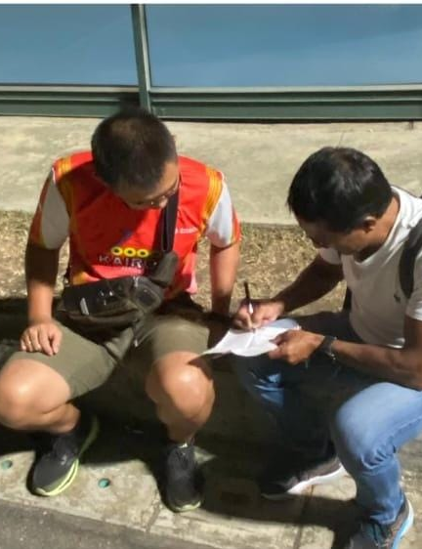
METHOD
DESCRIPTIVE ANALYTICAL
This study uses a descriptive analytical qualitative method .
MAIN DATA SOURCE
The main data sources in this research are notes and documentation from the coaching team and the Central Java PORSEROSI officials, which are then used for analysis
The study aims to gain a deep understanding of how the Central Java Roller Sport Team for PON XXI / 2024 was formed and how it achieved a significant leap in performance compared to previous PON Presentations.

Slide 5

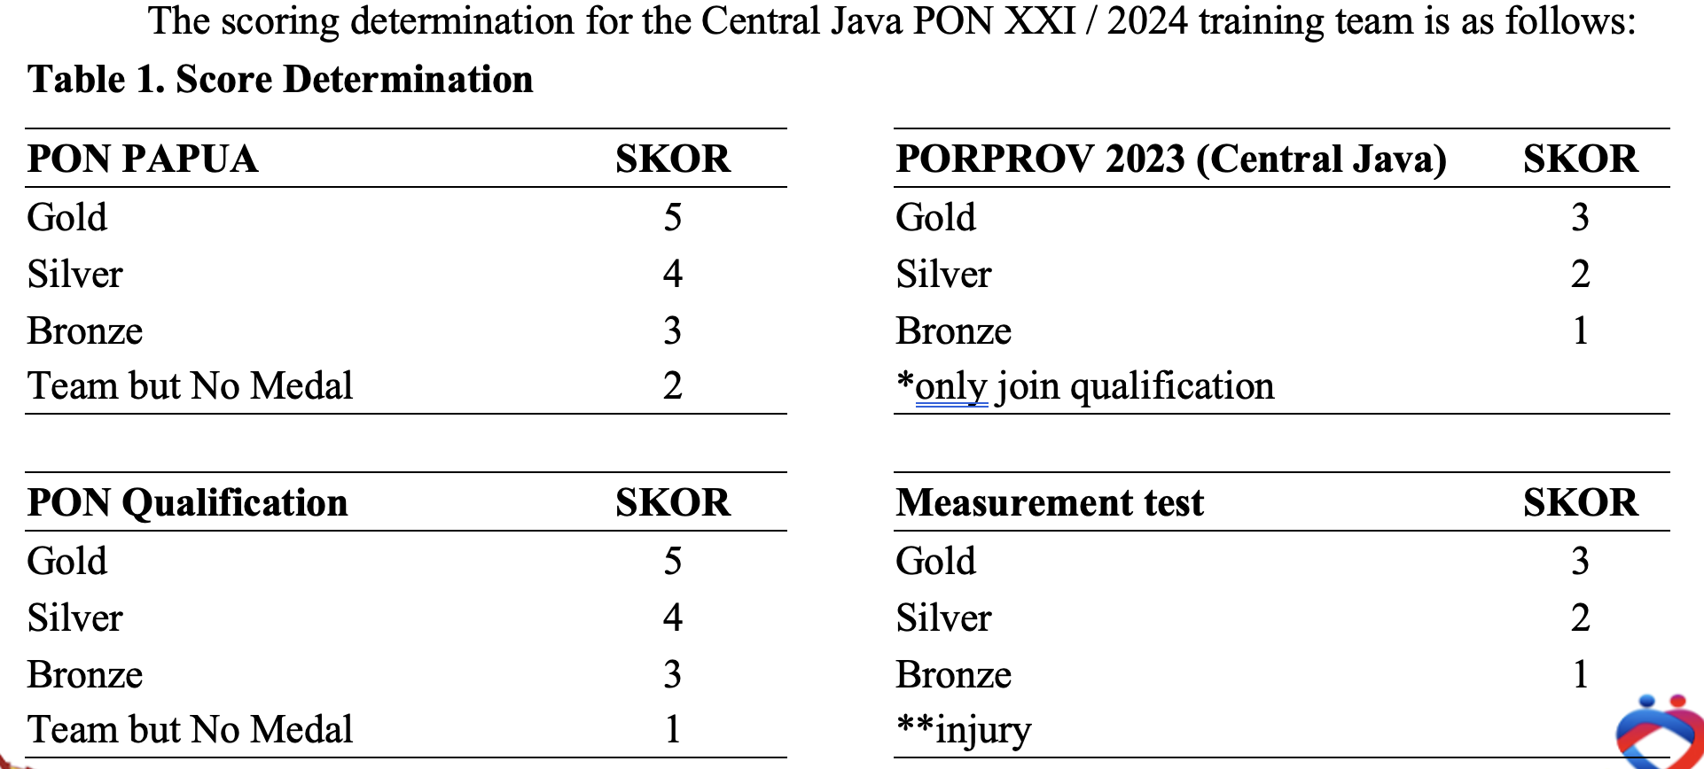
RESULT
Scoring System. To determine the scoring system, references were made to interviews with international coaches who have led their countries such as Colombia to become world champions. From these interviews, it was concluded that in the context of national multi-event competitions, the highest scores are given, followed by provincial multi-event competitions, and lastly by measurement tests conducted internally by coaches and federation officials.

Slide 6
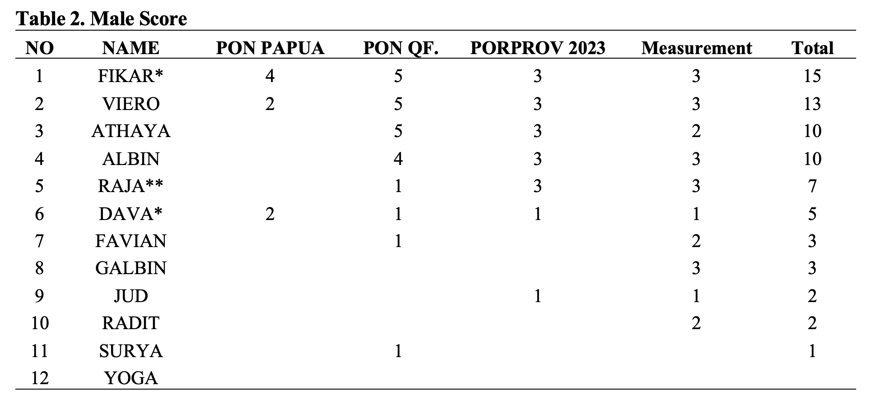
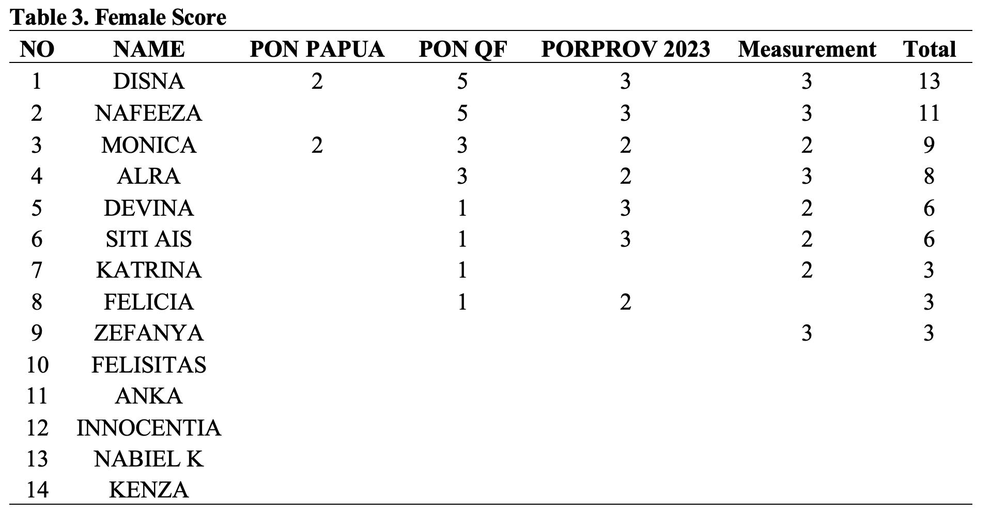
After the scores were determined, the projected athletes for the training team were then ranked based on the scores they obtained, as follows
Based on the scoring results, rankings 1 to 4 were designated as the Core Team for PON XXI / 2024 Central Java. Meanwhile, athletes ranked below them who still earned points would fill additional quota spots outside the core team, as provided by Central Java Government, up until the final deadline for team selection.

Slide 7
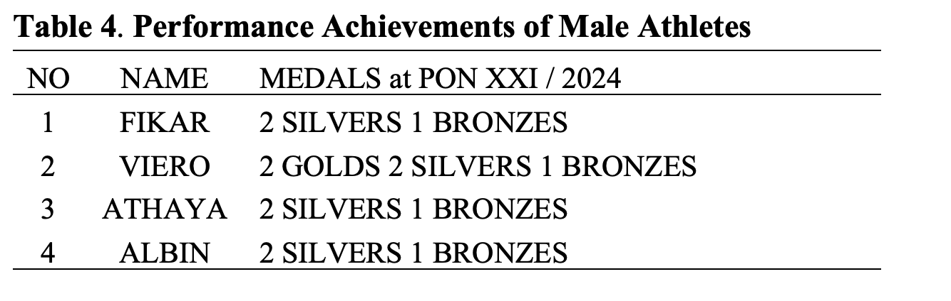
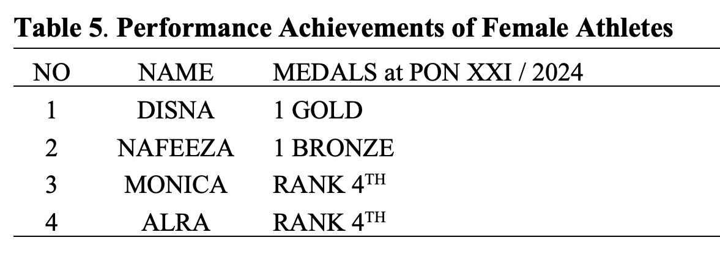
Discussion
The performance results of the core male athletes from the PON XXI / 2024 Aceh – North Sumatra team are shown in the following table 4 & 5
Based on the medal achievements, it can be seen that 6 out of 8 core team athletes from Central Java succeeded in winning medals at PON. Even the 2 athletes who did not win medals still showed good performances by placing 4th overall.
This scoring method also protects high-performing athletes to remain in the team. It anticipates situations where, during the final measurement test, an athlete might be injured or sick their prior achievements are still considered, and they are not immediately disqualified. Likewise, it prevents athletes who suddenly perform well in a single internal test from being selected without considering their competition experience and performance under pressure at higher-level events.
With the scoring method applied during the Central Java PON XXI / 2024 training program which resulted in improved medal achievements compared to previous PON it can be concluded that the core athletes were not selected based on a single test or event, but through a long journey across various competitions over four years. This ensures that the athletes chosen are consistently high-performing and reach peak performance at PON or within the targeted training periodization.

Slide 8
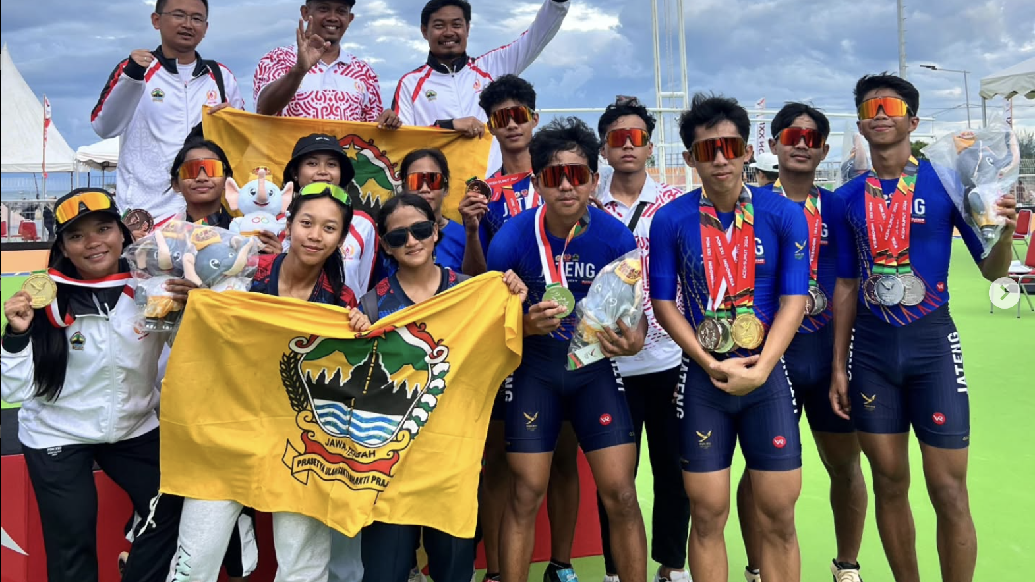
Conclusion
The scoring method used to determine the team for the Roller Sport discipline has been successfully implemented in the Central Java PON XXI / 2024 training team (Pelatda).
The improvement in achievements from 1 silver and 1 bronze to 3 golds, 3 silvers, and 2 bronzes within four years represents a significant leap in performance. With the accountability and transparency applied, the final core team formed was able to achieve optimal results, suggesting that this method could potentially be applied in the selection of the Indonesian national team or even in ASEAN countries that are currently developing their
Roller Sport programs.

Slide 9
THANK YOU

