Slide 1



Analysis of Attacking and Defensive Tactics of the Indonesian National Football Team in the 2024 Asian Cup
Fajar Awang Irawan, Heny Ngatifah, Dhias Fajar Widya Permana, Aziz Amrulloh, Primawati Suciani, Agil Kusuma Wardhana, Romayuli
Universitas Negeri Semarang, Indonesia

Slide 2
INTRODUCTION
Football is the most popular sport that is of interest to the Indonesian people, even Indonesia is called the country with the 3rd most fanatical fans in the world after England and Argentina.
According to the results of observations on the Indonesian U-23 National Football Team during the Asian Cup, it shows that the attacking and defensive strategy have never been published in academic research results.
The purpose of this study is to analyze the attacking and defensive strategies used by the Indonesia U-23 National Football Team in the 2024 Asian Cup match.

Slide 3

METHOD
Research Design
The research method used in this study is quantitative with a Descriptive Analysis approach.
The study uses live match and recording videos of the Indonesian U-23 National Football Team in the 2024 Asian Cup, which are then analyzed to obtain quantitative data.
The variables in this study are the attacking strategy and the defensive strategy of the U-23 National Team in the 2023/2024 Asian Cup season.
Population
The research is categorized as digital-based using online through match video observations and collected on the official YouTube account of the AFC Asian Cup and You Tube Channel.
Data collection in this study was carried out from December 12, 2024, to December 18, 2024, to obtain data that would then be analyzed.

Slide 4
METHOD
Procedure
The research instrument includes 11 attacking indicators; shot on target, heading, free kick, penalty, corner kick, through pass, crossing, passing, throw-in, long ball, and shooting,
And 12 defensive indicators; tackling, body charge, blunder, penalty save, saving, foul, clearance, blocking, intercept, offside, ball control, and goal kick.
A total of 5 videos were taken as samples, with 21 players ranging from starting players to substitutes used by the coach. Data analysis stage, namely analyzing the data obtained using Kinovea 0.9.5 software.
Data Analysis
Analysis technique presenting data in a concise and systematic manner and can also provide a general overview related to the team’s performance, such as accurate passing, number of shots, number of fouls, and others.

Slide 5
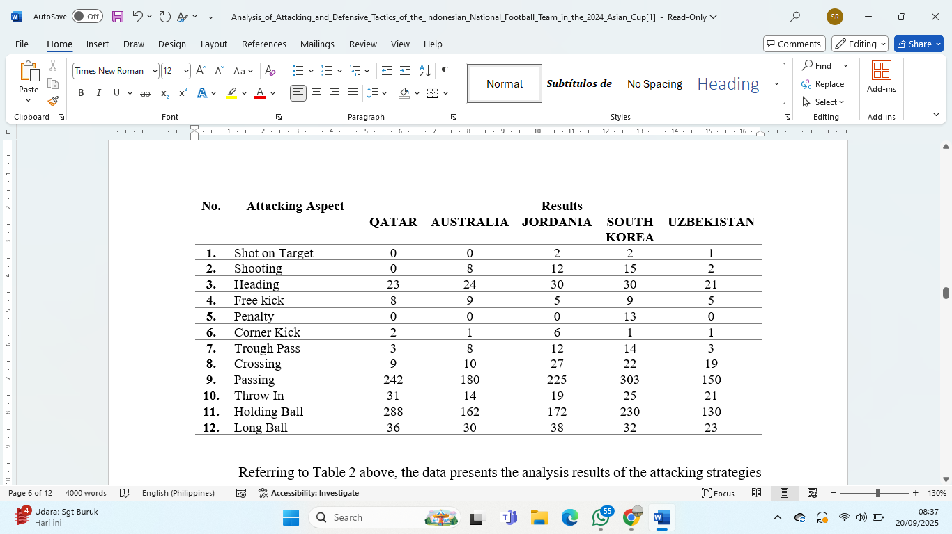
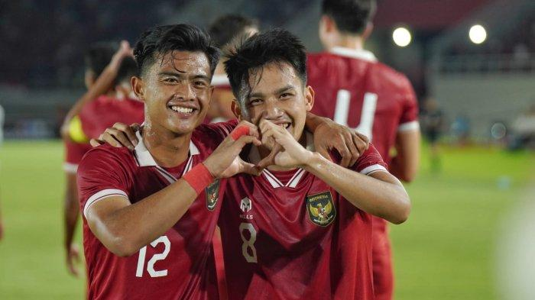
RESULTS
There are two types of attacking strategies used by the Indonesian U-23 National Football Team;
dynamic play strategies and set-piece strategies.
The dynamic play strategies employed by the Indonesian U-23 National Football Team include crossing, long balls, and counterattacks.
The set-piece attacking strategies involved heading and throw-ins.

Slide 6
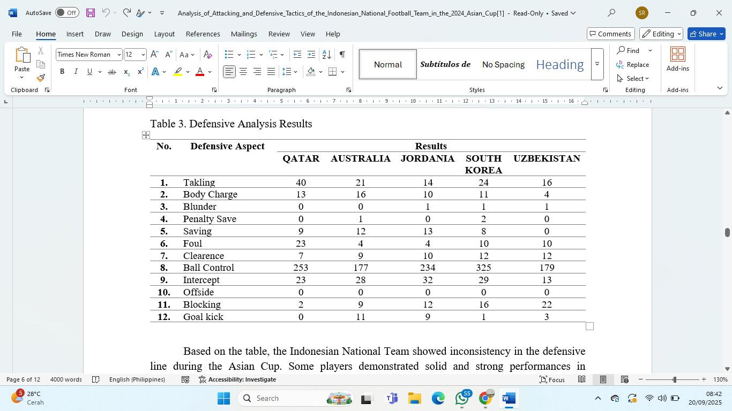
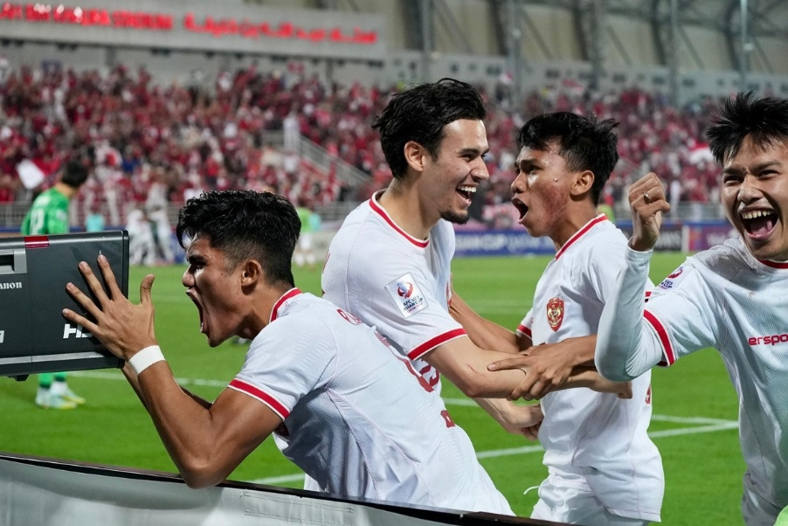
RESULTS
Based on the table, the Indonesian National Team showed inconsistency in the defensive line during the Asian Cup.
Some players demonstrated solid and strong performances in maintaining defense, but quite a few still made errors.
The high number of tackles in the statistics proves that the defenders worked hard to block the opponents’ attacks, with players averaging 23% tackles.
In addition to tackles, Indonesian players also frequently performed interceptions, averaging 25% throughout the matches in the 2024 Asian Cup

Slide 7
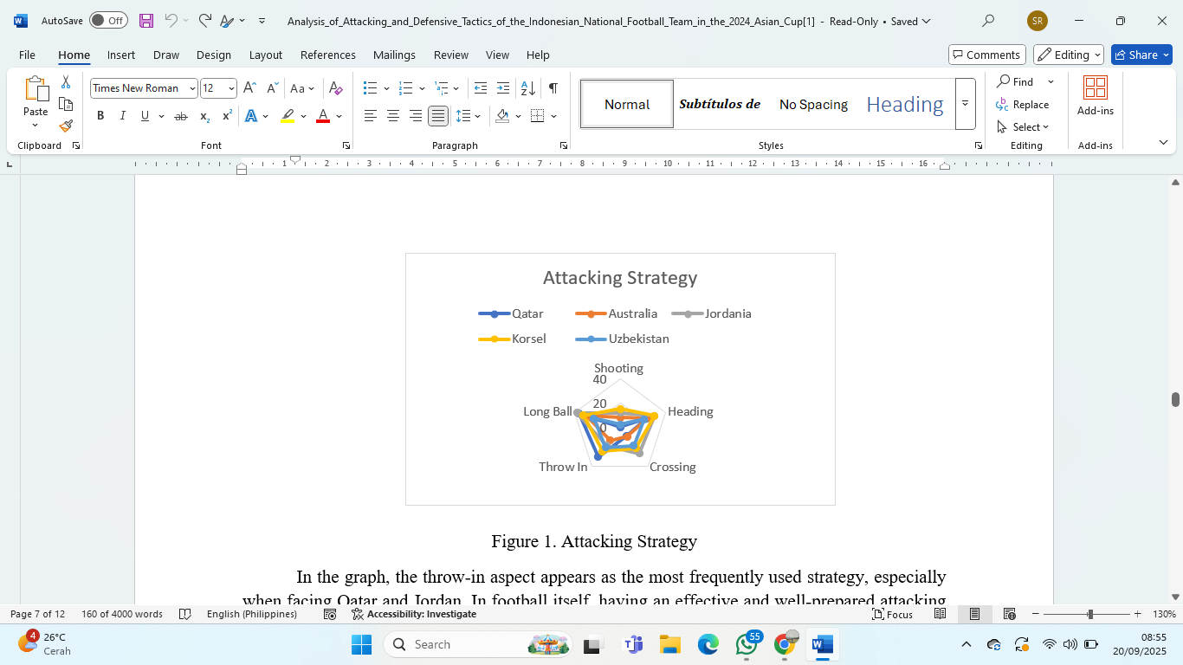
RESULTS
In the graph, the throw-in aspect appears as the most frequently used strategy, especially when facing Qatar and Jordan.
From the five data points in the graph, it can be explained that the Indonesian U-23 National Team used wing attacks in the form of overlaps and utilized set pieces such as throw-ins.

Slide 8
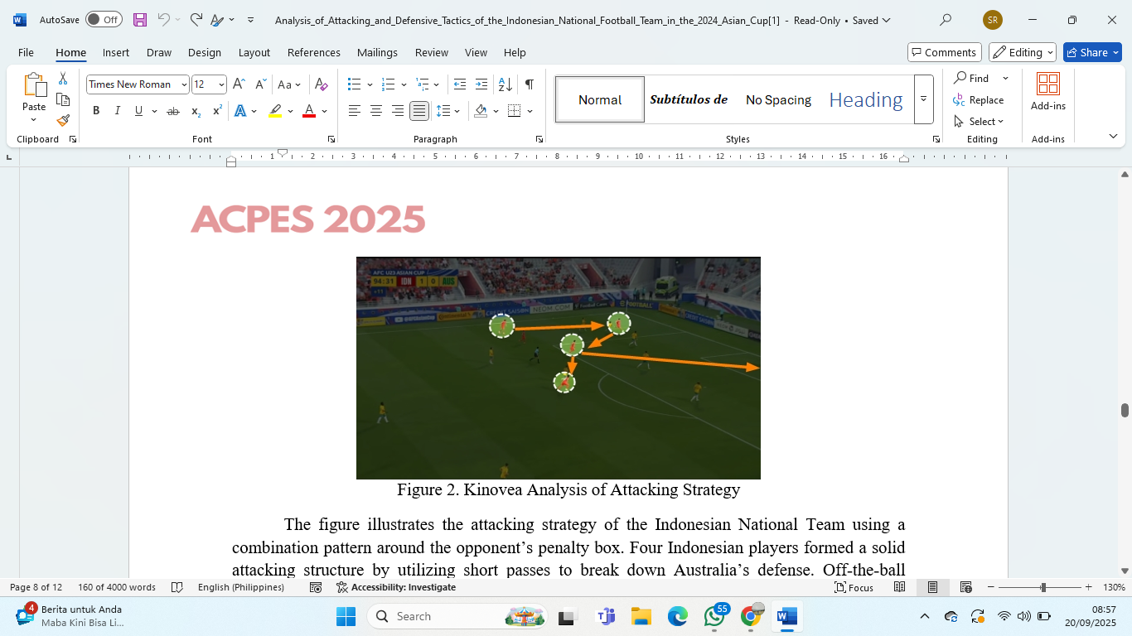
RESULTS
Analysis using Kinovea 0.9.5
The figure illustrates the attacking strategy of the Indonesian National Team using a combination pattern around the opponent’s penalty box.
Four Indonesian players formed a solid attacking structure by utilizing short passes to break down Australia’s defense.
Off-the-ball movements were also clearly executed, with several players moving to find open spaces, creating passing lanes as well as opportunities to draw defenders out of their zones.

Slide 9
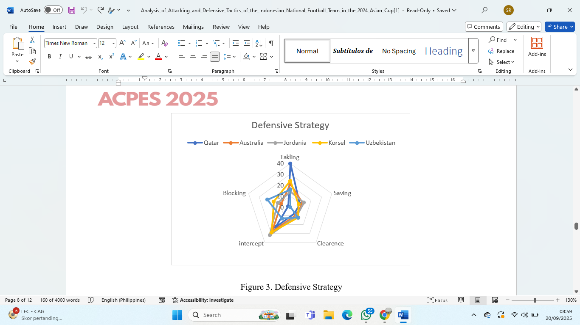
RESULTS
Based on the graph, tackling appears as the most important element most frequently performed by the defenders, especially when facing Jordan.
Based on the analysis, in defensive situations, Indonesia tended to create a deeper defensive line when facing aggressive attacks and opponents with strong individual skills.

Slide 10
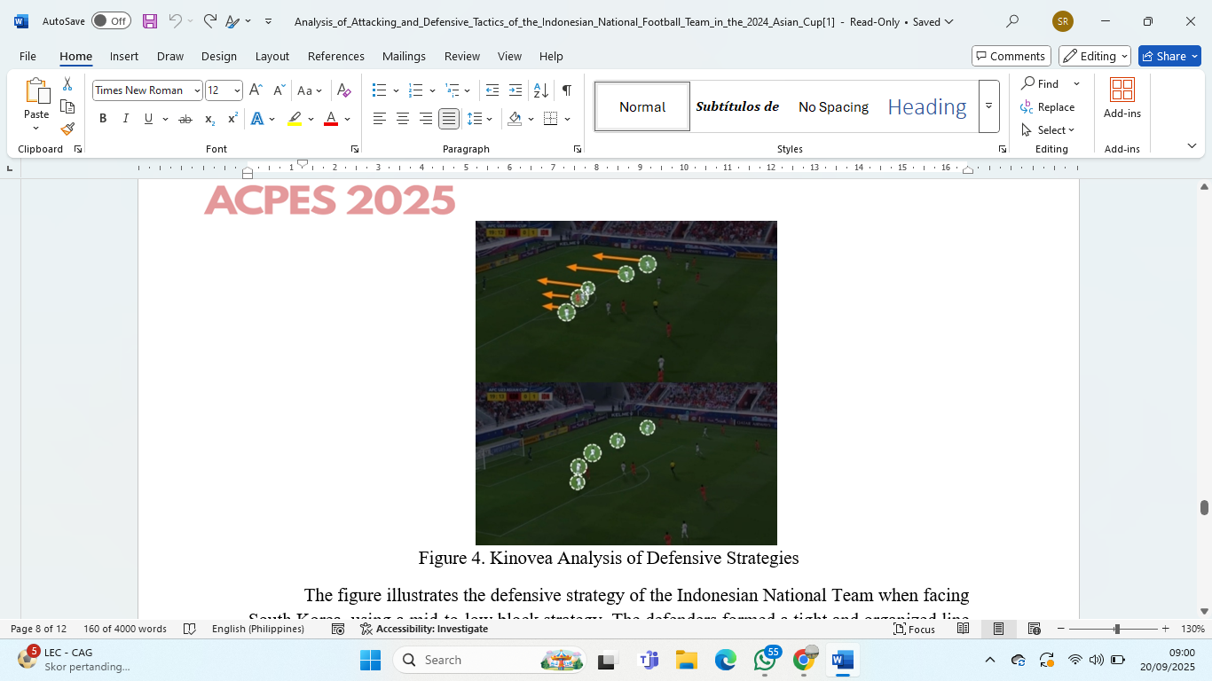
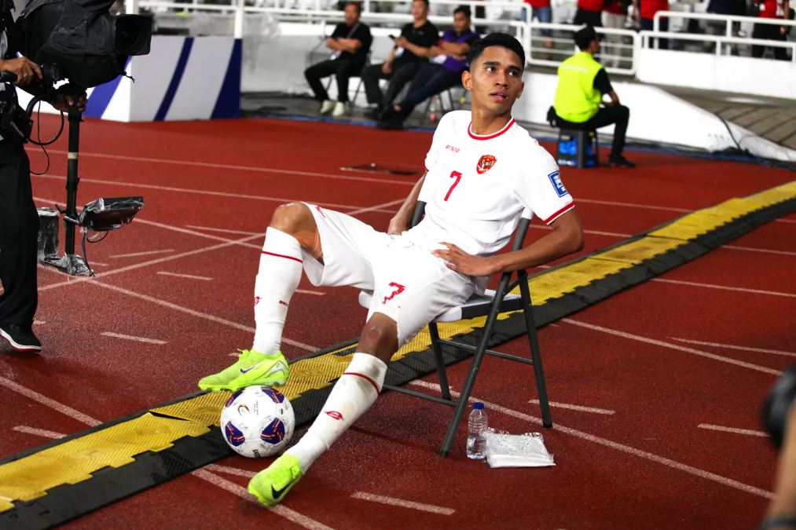
RESULTS
The figure illustrates the defensive strategy of the Indonesian National Team when facing South Korea, using a mid-to-low block strategy.
The defenders formed a tight and organized line around the penalty box to limit the movement of South Korean players.

Slide 11
CONCLUSION
This study found that The analysis of the attacking strategy of the Indonesian U-23 National Football Team in the 2024 Asian Cup using counterattack and crossing combination patterns, is considered effective, allowing Indonesian players to exploit gaps in the opponent’s high defensive line, while crossing serves as a tool to create goal opportunities.
The analysis of the defensive strategy of the Indonesian U-23 National Football Team in the 2024 Asian Cup, using disciplined situational pressing and mid-to-low block patterns, is considered effective in narrowing space in the defensive area, forcing opponents to attack in less critical zones.
Meanwhile, situational pressing is utilized to intercept the ball before it reaches critical areas in the defensive line.
The limitation of this study is that the tactical analysis was conducted based on visual observation, which is subjective and prone to individual interpretation.
For future study, it is recommended to use advanced statistical data such as expected goals (xG), expected assists (xA), pressing counts per zone, and player GPS data to achieve more objective results.

Slide 12
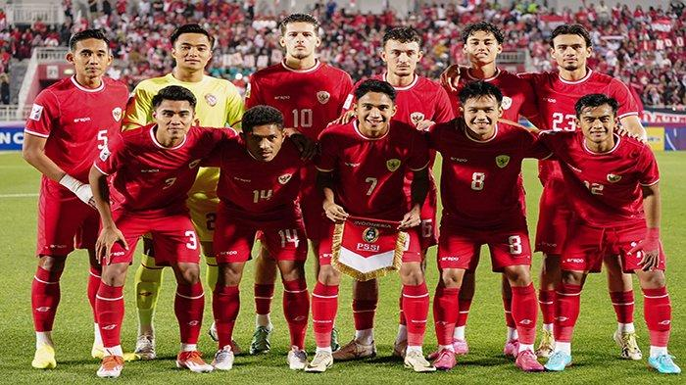
SALAMAT PO

